Slide 1

Azure devops
By: cC

Slide 2
What is it?
Azure DevOps Services provides development collaboration tools including high-performance pipelines, free private Git repositories, configurable Kanban boards, and extensive automated and cloud-based load testing.
Use all the DevOps services or choose just what you need to complement your existing workflows
Discover flexible integrations mixing and matching the modular Azure DevOps tools to best fit your needs. Complement them with your existing tools and IDEs, and hundreds of integrations in the Marketplace.
Enterprise ready
Azure DevOps
Choose Azure DevOps for enterprise-grade reliability, including a 99.9 percent SLA and 24×7 support. Get new features every three weeks.
On-Premises
Manage your own secure, on-premises environment with Team Foundation Server. Get source code management, automated builds, requirements management, reporting, and more.

Slide 3
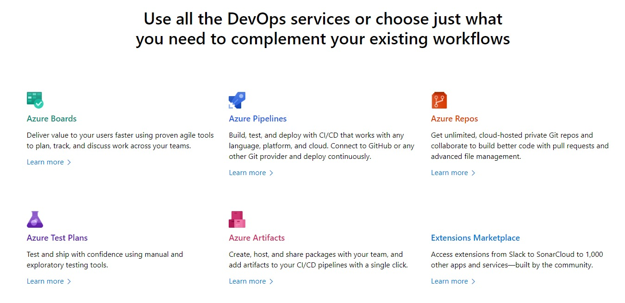

Slide 4
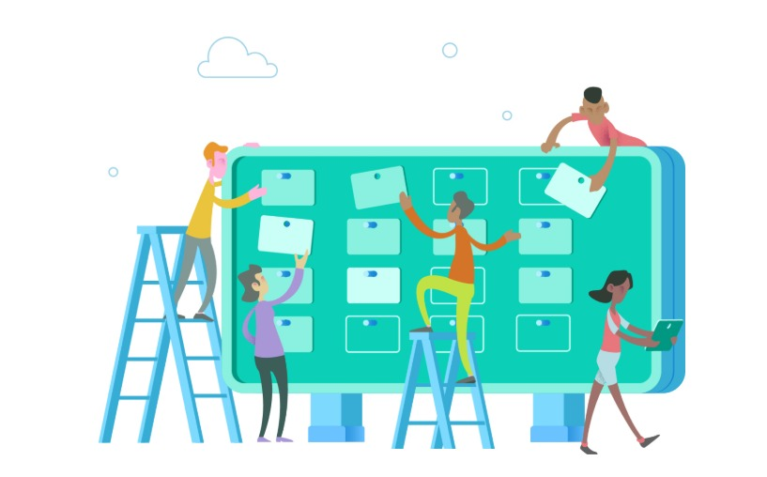
Azure Boards
Track work with Kanban boards, backlogs, team dashboards, and custom reporting.
Combine drag-and-drop sprint planning and flexible work item tracking with comprehensive traceability to have the perfect home for all your ideas–big and small.
Track all your ideas at every development stage and keep your team aligned with all code changes linked directly to work items.
Use built-in scrum boards and planning tools to help your teams run sprints, stand-ups, and planning meetings.
Gain new insights into the health and status of your project with powerful analytics tools and dashboard widgets.

Slide 5
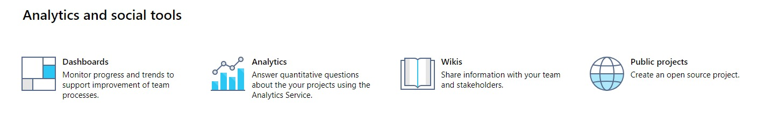

Slide 6
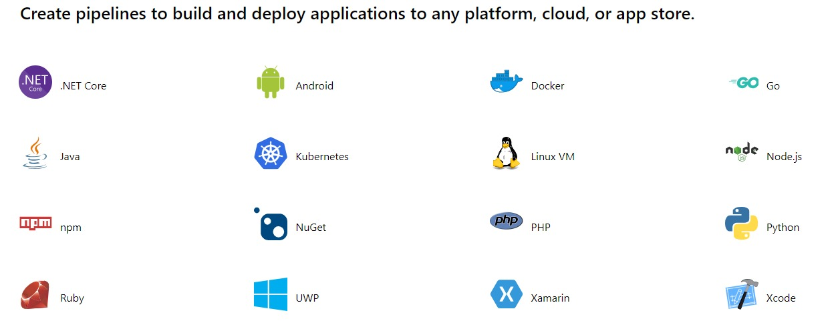
Azure pipelines
Azure Pipelines helps you implement a build, test, and deployment pipeline for any app. Tutorials, references, and other documentation show you how to configure and manage continuous integration and continuous delivery (CI/CD) for the app and platform of your choice.

Slide 7
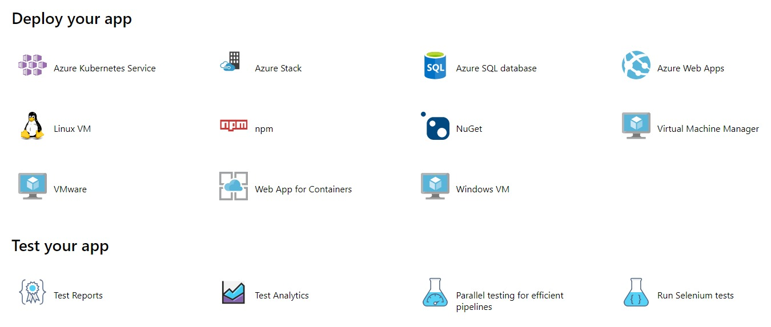

Slide 8
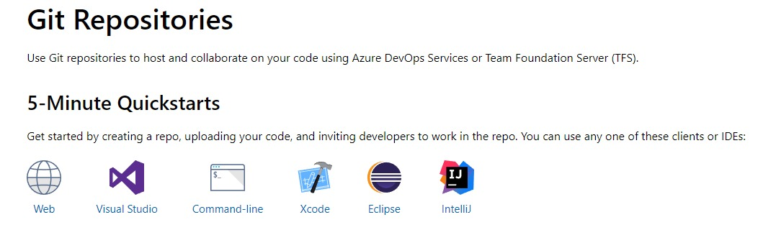
Azure Repos
Collaborate on code development using free Git public and private repositories, pull requests, and code review.

Slide 9
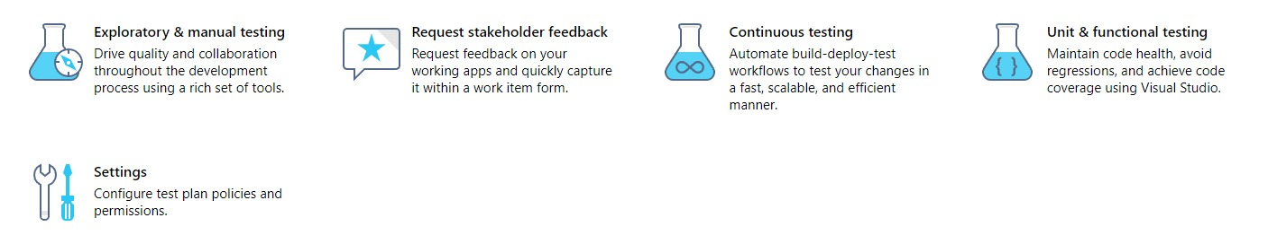
Azure Test Plans
Improve your overall code quality by using manual and exploratory testing services for your apps.

Slide 10
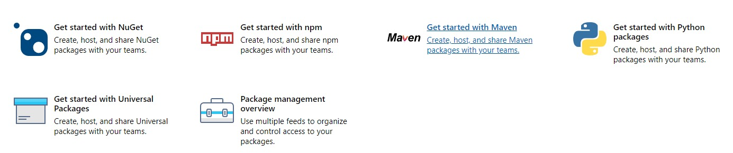
Azure Artifacts
Code once and share packages across your organization. Host your private Nuget, npm, and Maven packages with Azure Artifacts for more reliable, scalable builds.

Slide 11
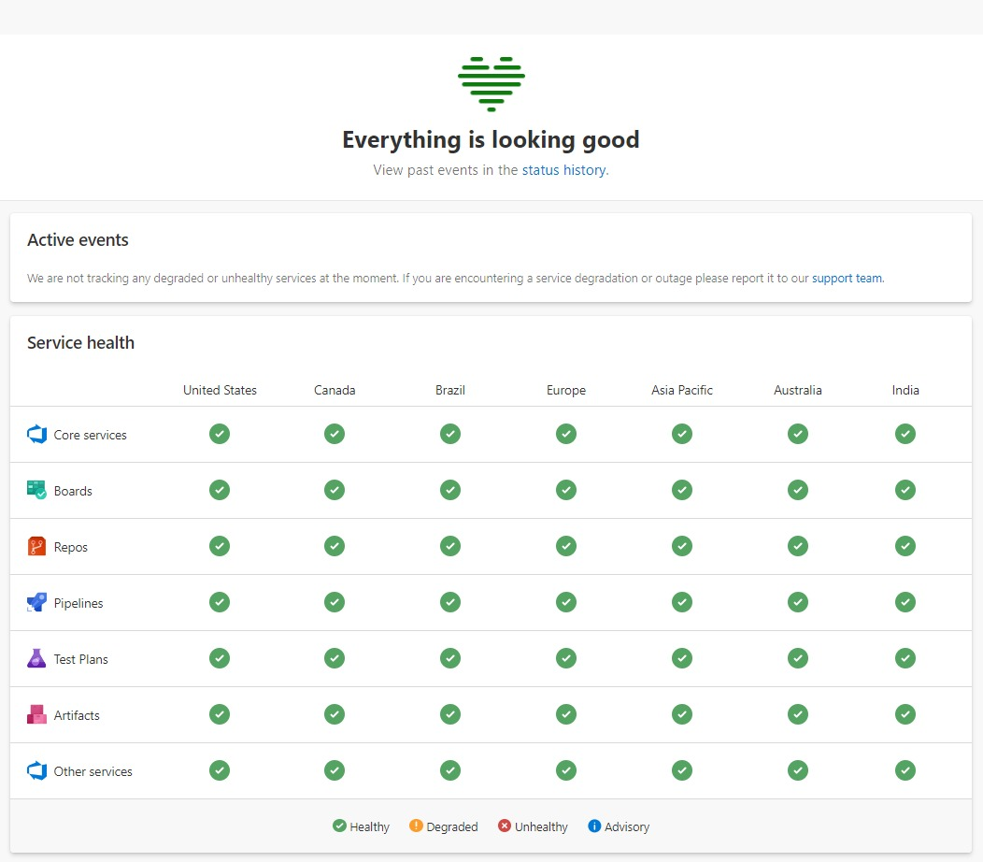
Dev Ops Status

Slide 12
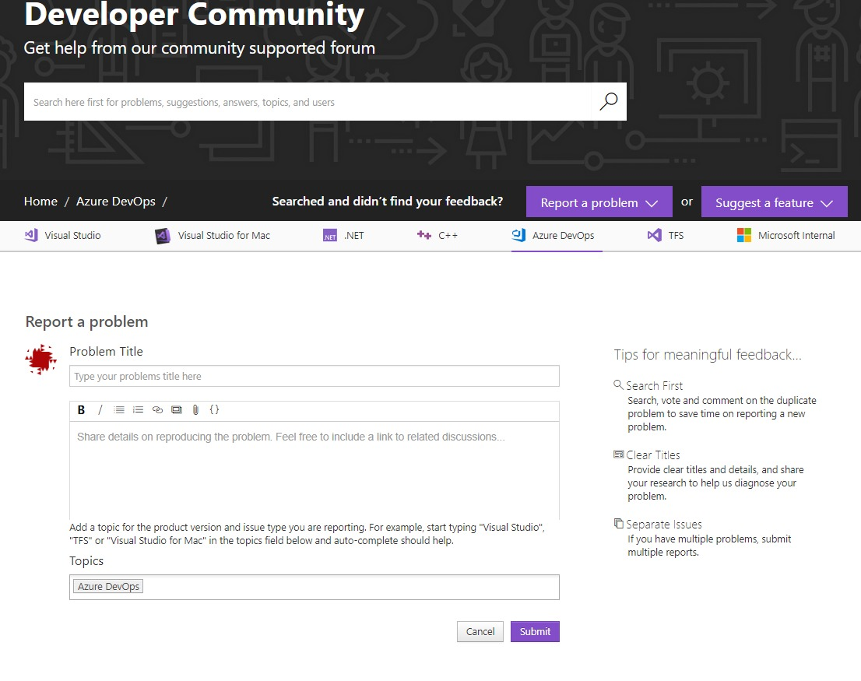
Dev Community

Slide 13
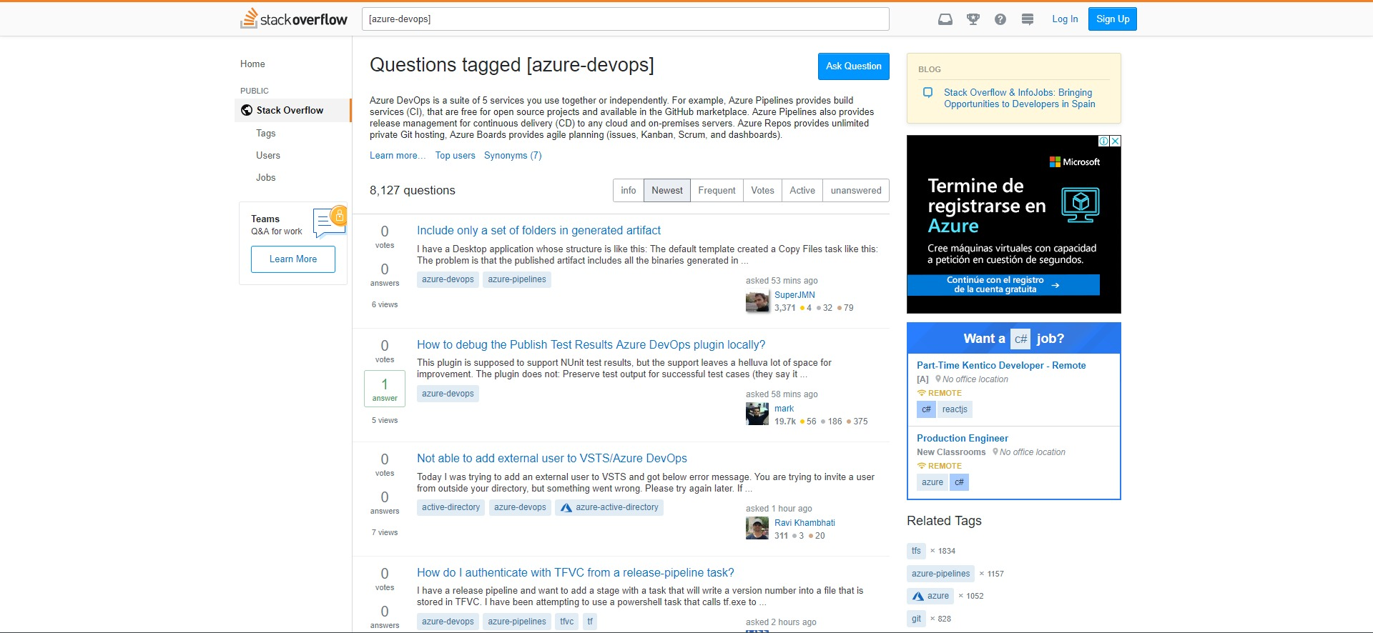
STACKoVERFLOW

Slide 14
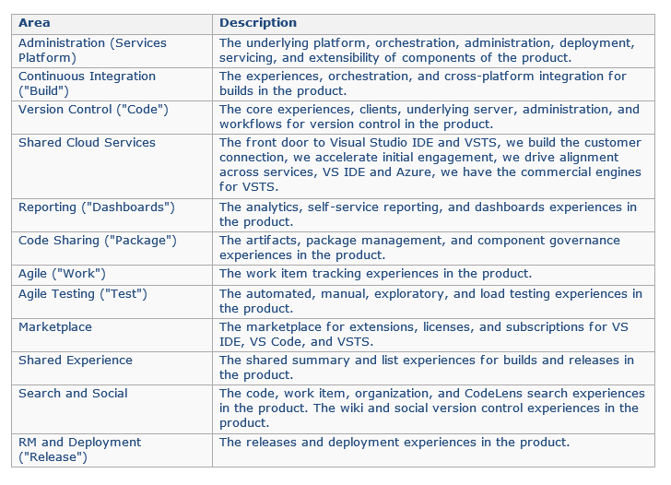
tYPIFICATION

Slide 15


Questions

